Slide 1
Machine Learning Models in Object Detection
Henry Hsia
University of California, Santa Barbara
JYPE Student
Prof. Kazuya YOSHIDA
Prof. Shreya SANTRA
8/1/2024

Slide 2
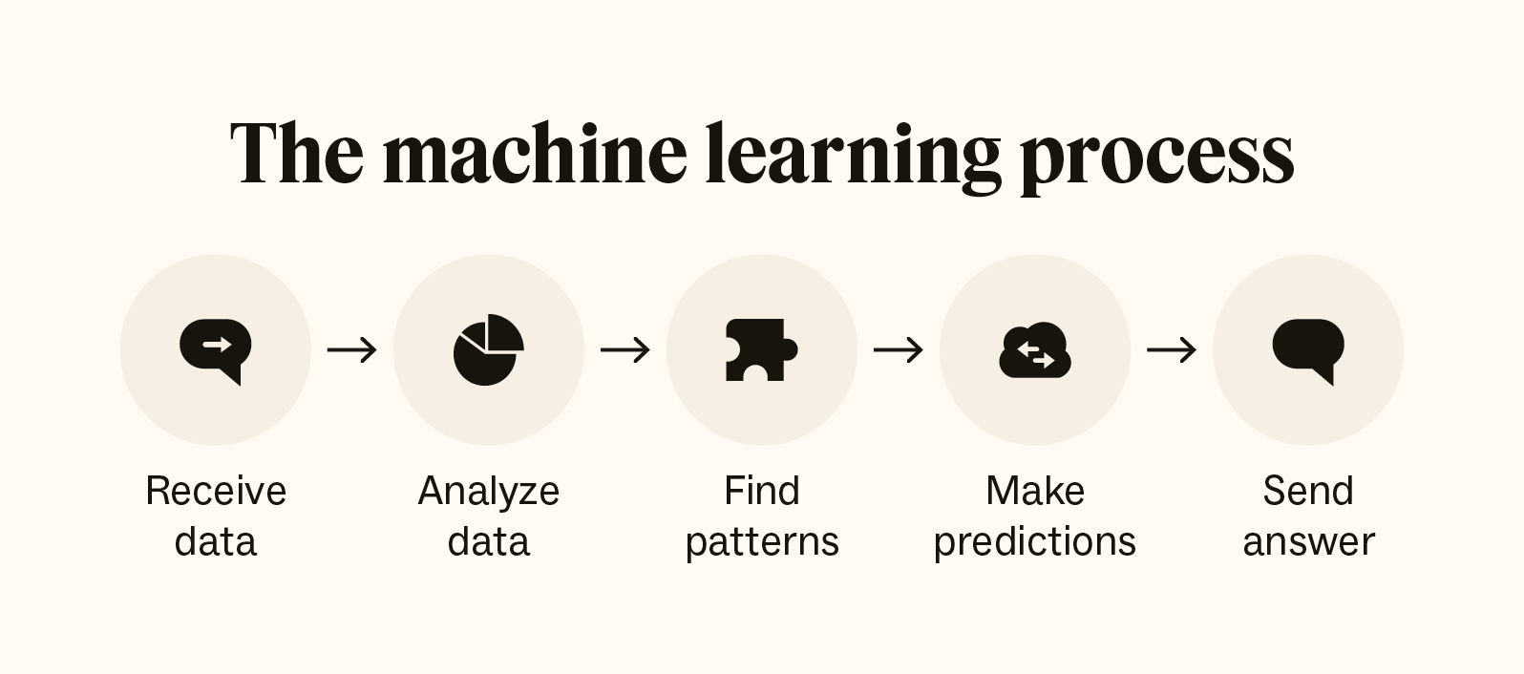
Background
Machine learning uses data and algorithms to imitate how humans learn, gradually improving accuracy
Most well known example: ChatGPT was trained on a huge amount of text data to model human conversation
We will be using machine learning to detect objects in real time

Slide 3
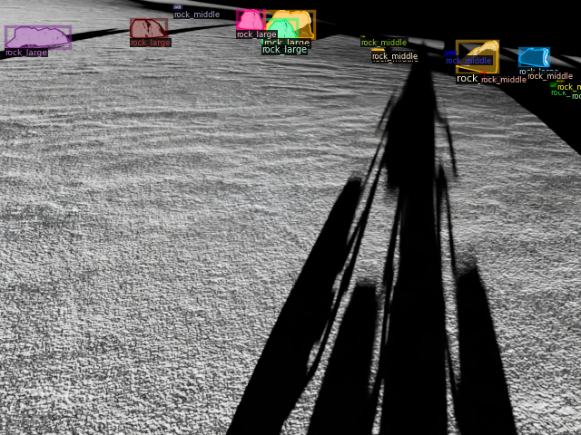
Purpose
A real-time object detection model can detect changes in the environment as they are happening
Can also detect these changes relatively accurately with low computing resources
As such, generated models can assist with autonomous rover navigation

Slide 4



Programs Used
Ultralytics Yolov8: Object detection and image segmentation model that we will iterate on for our specific purpose
Roboflow: Image annotation and dataset generation
OmniLRS: Lunar robotics simulator developed by Space Robotics Lab at Tohoku University and the University of Luxembourg

Slide 5
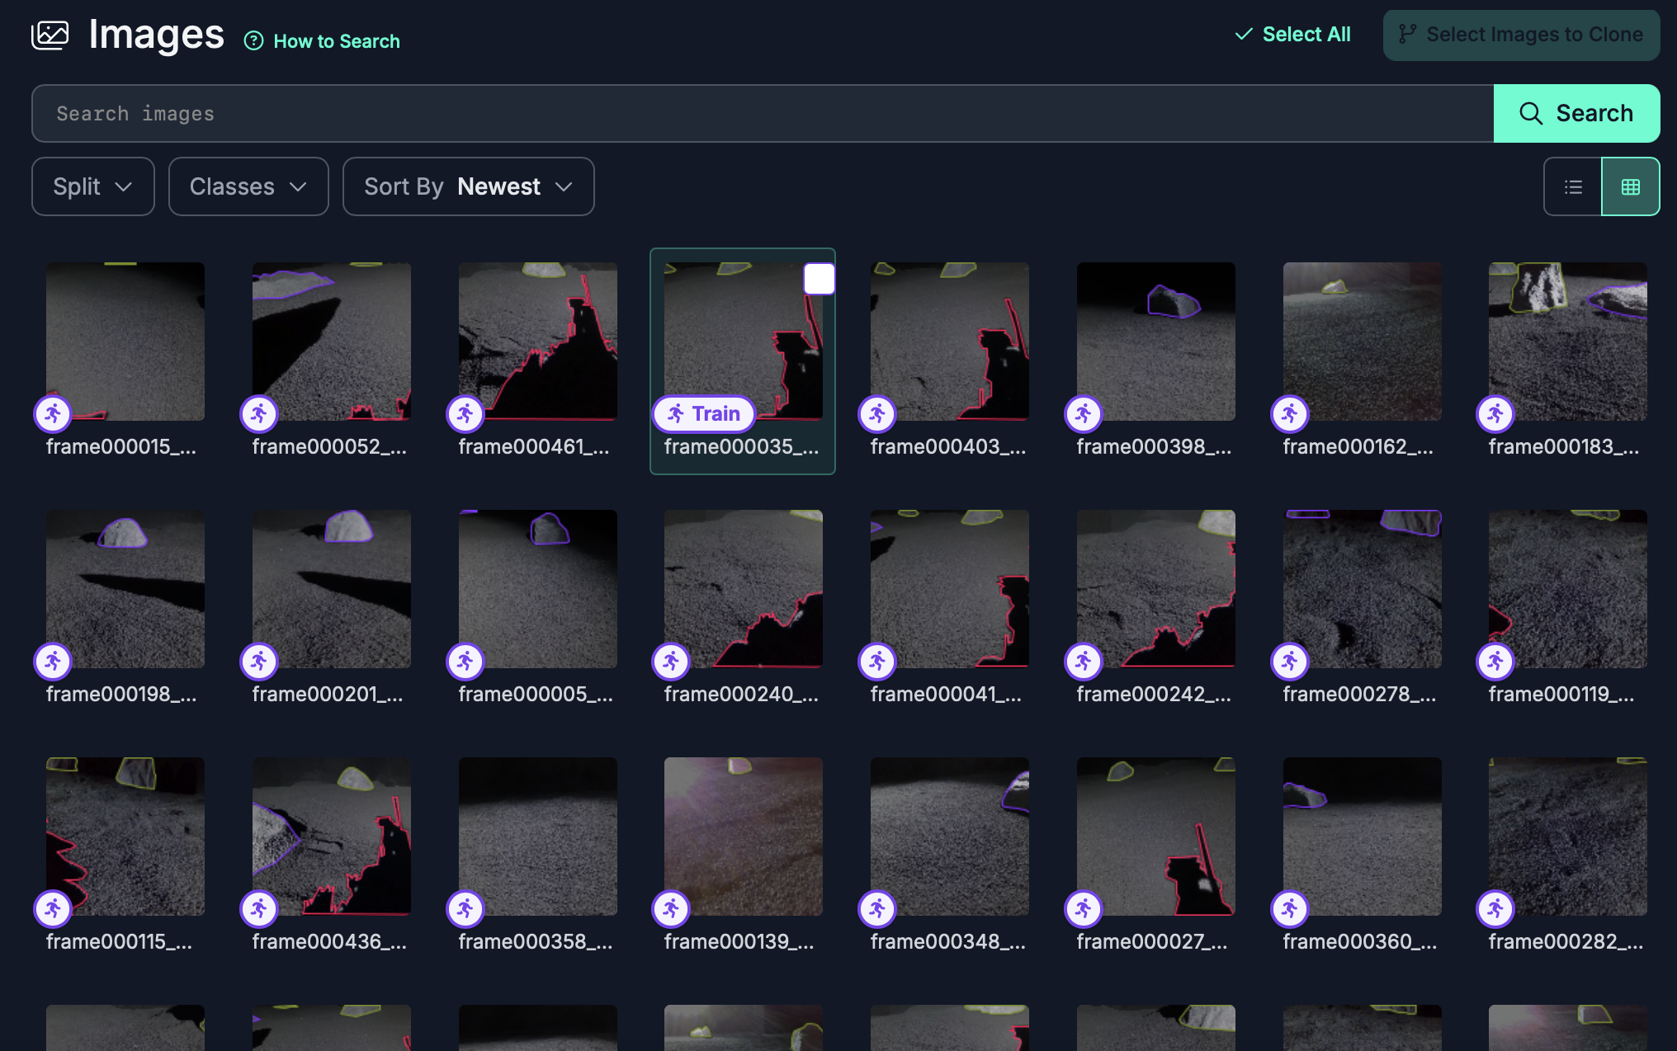
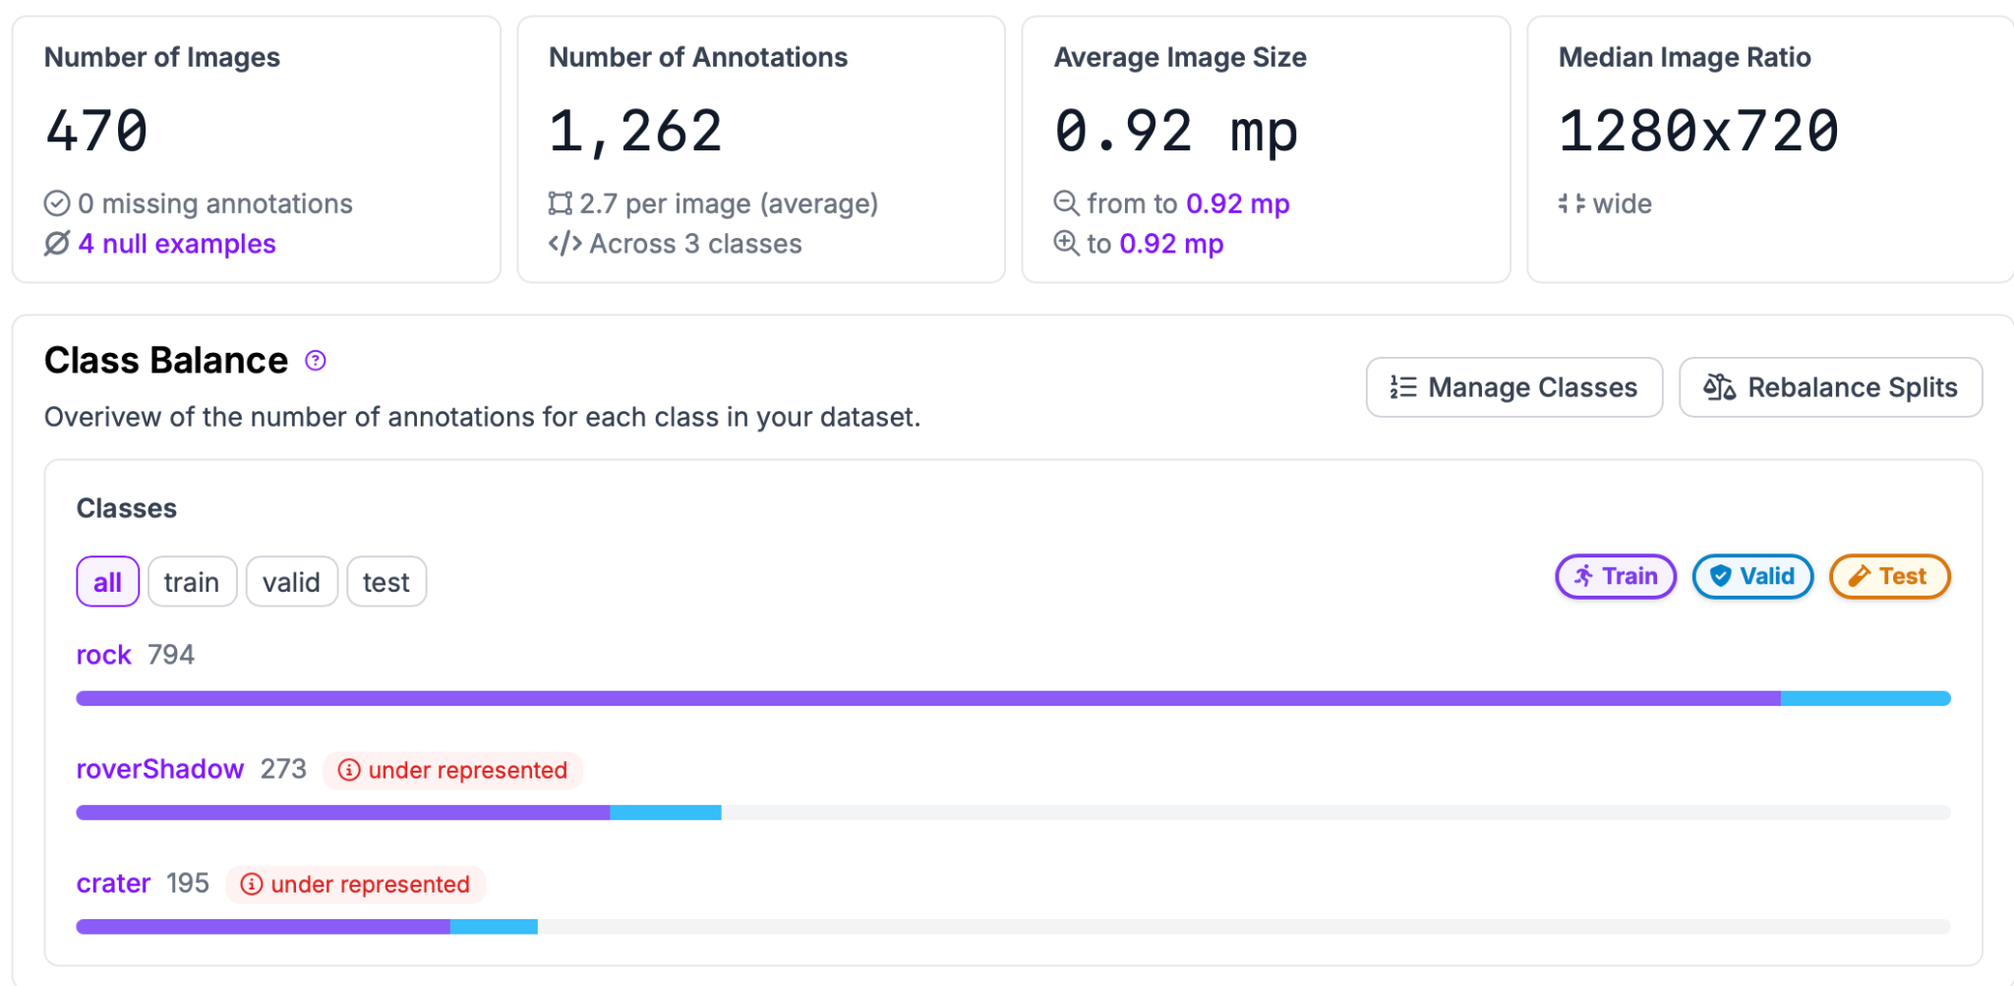
Generating a Dataset
We have to create a dataset for the model to train on
Dataset used 470 images of a real life simulated lunar environment
Dataset split into training and validation, training images are used to train the model, while validation images are used to evaluate the model’s performance
70% training/30% validation is a good baseline, we used a 90/10 split because of a high number of images

Slide 6
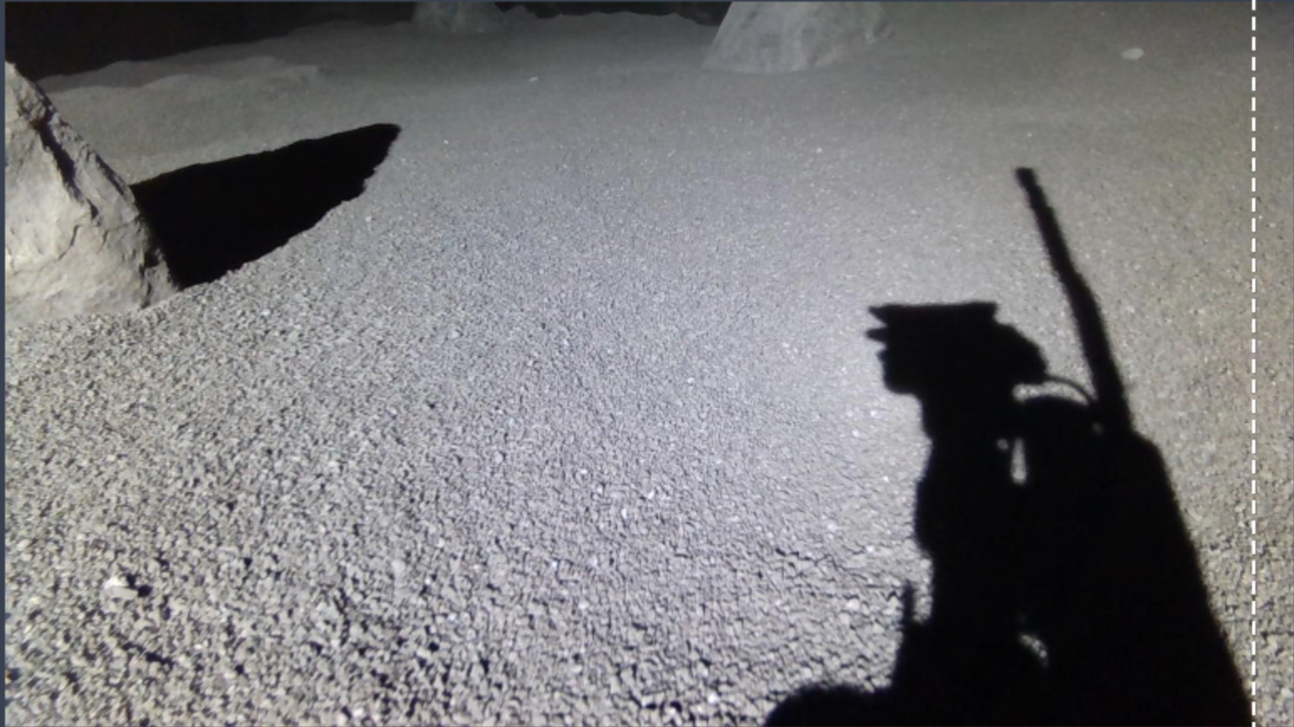
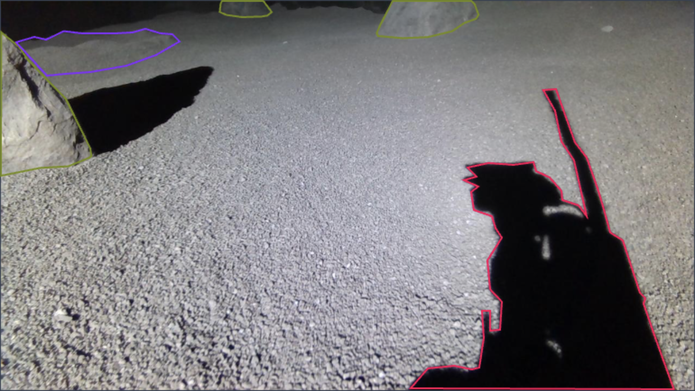
Annotating the Dataset
Objects that we are trying to detect must be annotated in the images
Our classes for our dataset will be rocks, craters, and the rover’s shadow
While you can use an AI assistant or a model for labeling, we hand labeled every image because of inaccuracies when labeling the shadows, and an inability to properly label the craters

Slide 7
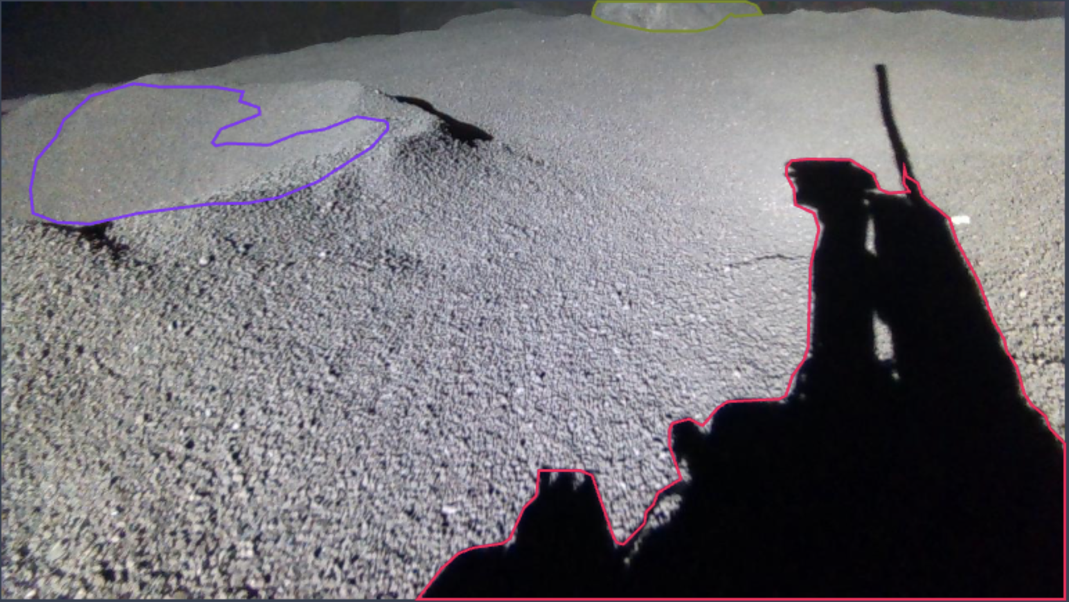
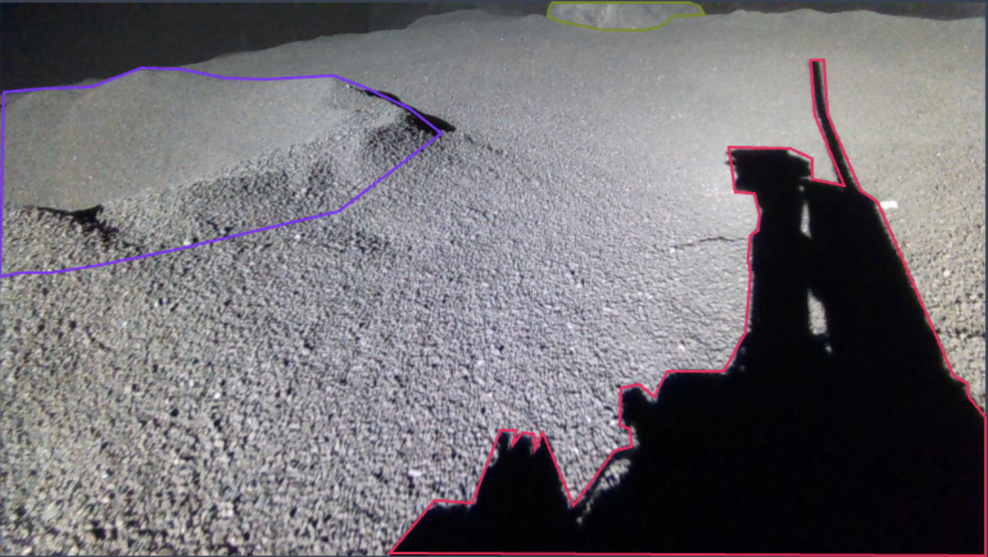
Example
AI Assistant
Hand Labeled

Slide 8
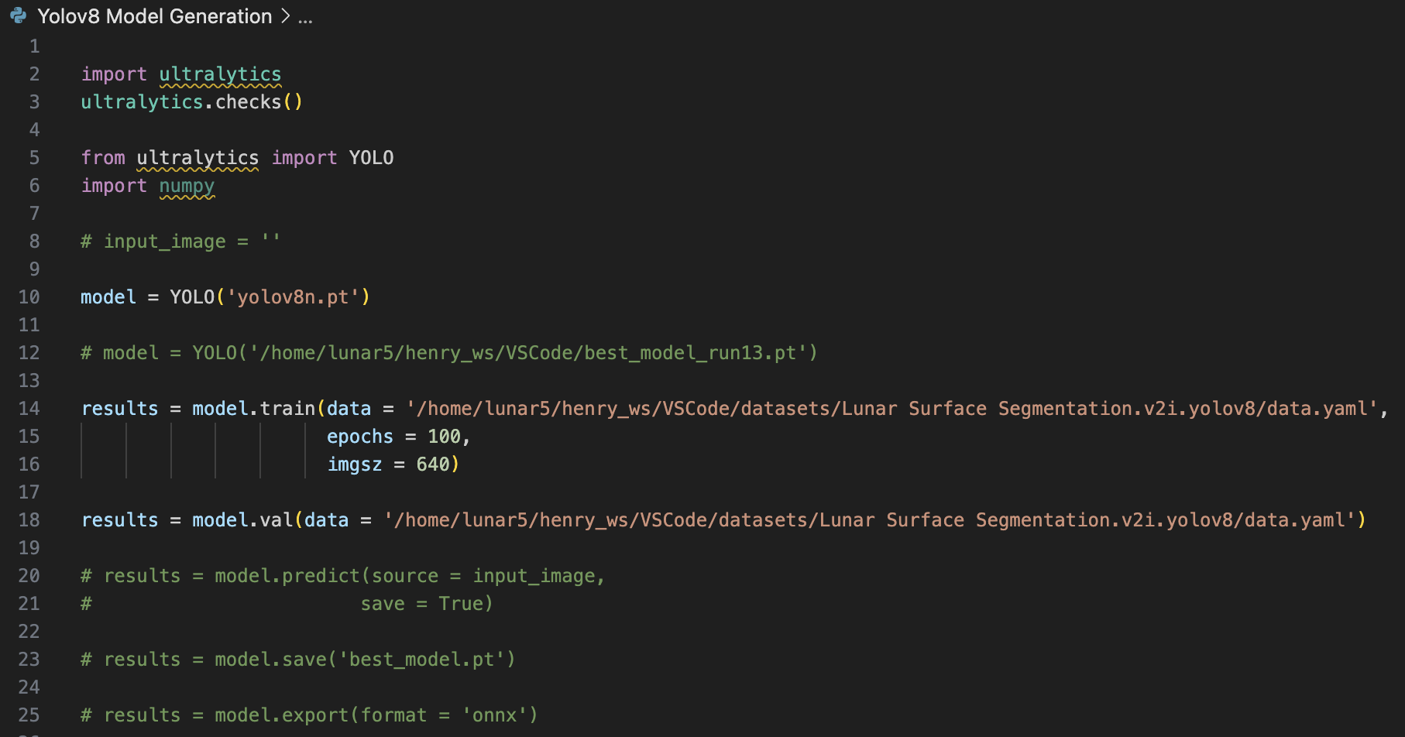
Generating Models
We can generate our model using different variants of Yolov8, image sizes, and epochs
Yolov8 comes in different speeds and complexities, from nano to extra large
The smaller the size, the less accurate the model is, but in turn it is faster and takes less computing power
Based on our purpose, we will use the smallest size, Yolov8n (nano)
Epochs, or folds are the number of times the entire dataset is iterated through

Slide 9
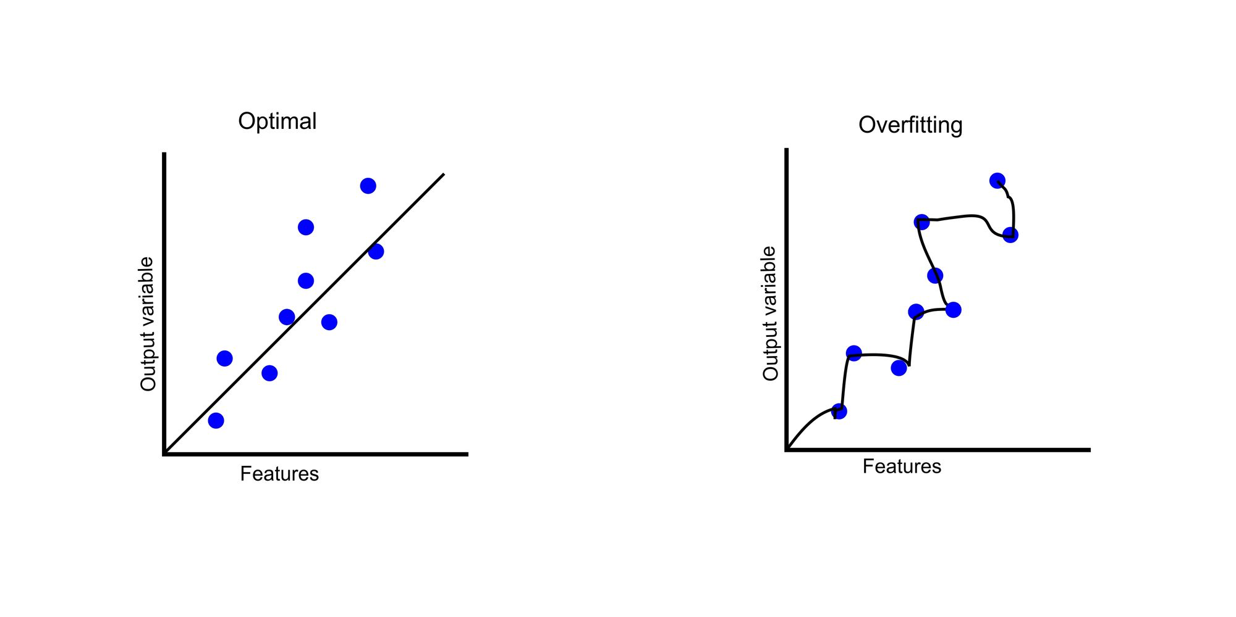
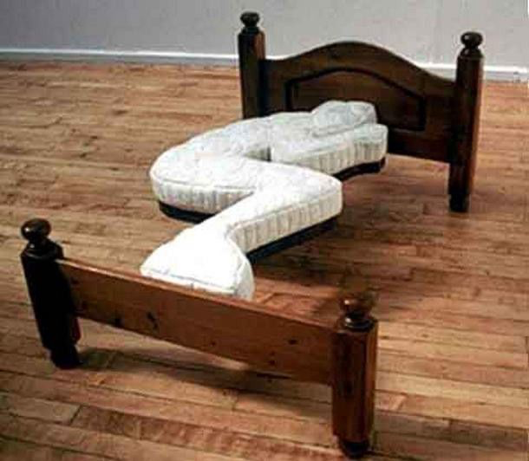
Why don’t we just use as many epochs as possible?
For the question of how many times we train the model on the entire dataset (epochs), it might seem to make logical sense that the more epochs, the better
However, after a certain point the model does not improve anymore and even regresses due to overfitting
Overfitting is when the model is too closely aligned to a particular set of data; it has been trained too many times on a specific dataset and picks up patterns that don’t actually exist

Slide 10
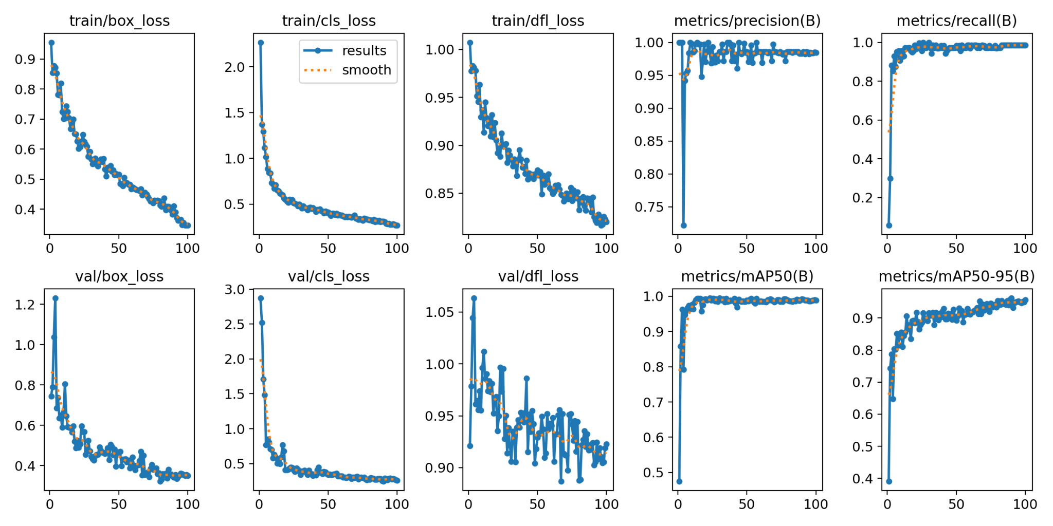
Interpreting Performance Metrics
To determine how well our model is performing we must understand the evaluation metrics
Box loss: Measures the error in predicted bounding box coordinates
Class loss: Measures the error in classifying detected objects into our 3 classes (rock, crater, roverShadow)
DFL loss: Emphasizes bounding box locations that are harder to predict
3 loss values for both training and validation part of the dataset
Precision: Ratio of true positive detections to total number of positive detections (true + false positives), higher precision indicates fewer false positives
mAP50 and mAP50-95: Mean average precision
Recall: Ratio of true positive detections to total objects, higher value indicates fewer false negatives

Slide 11
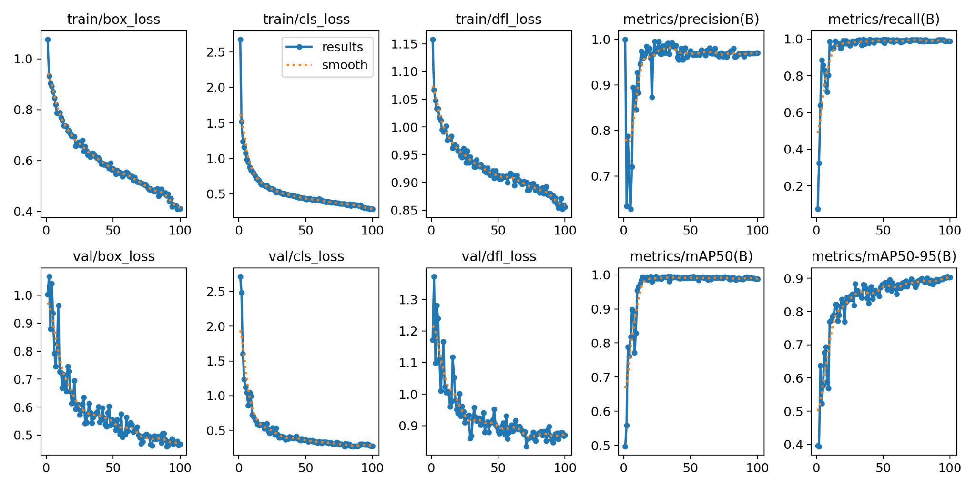
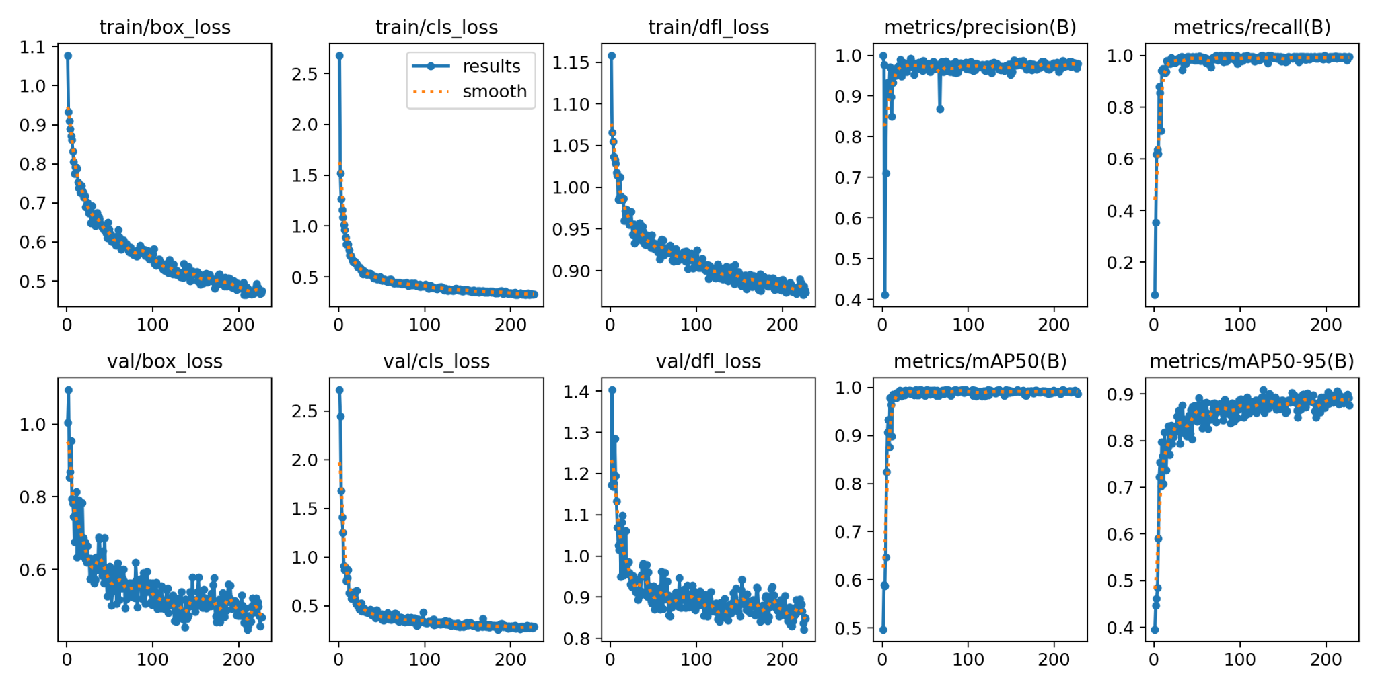
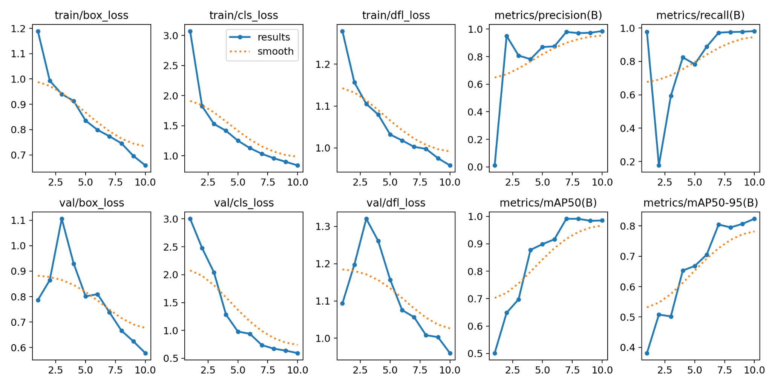
Results
100 Epochs
250 Epochs
10 Epochs

Slide 12
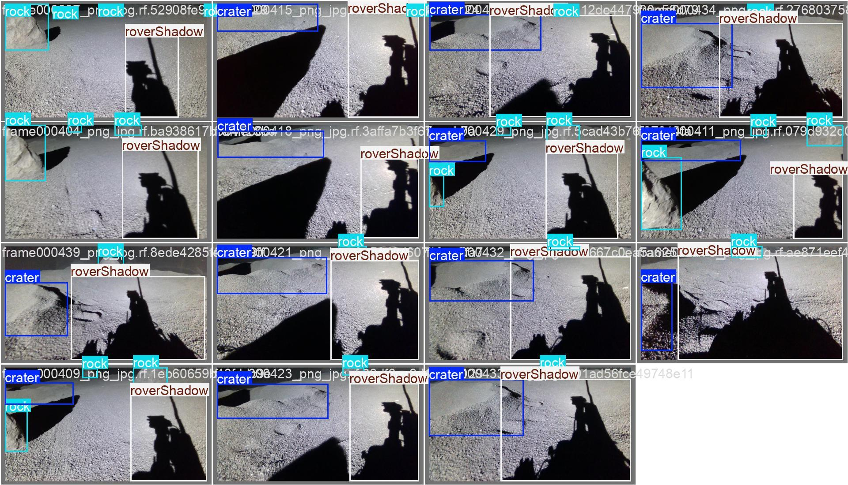
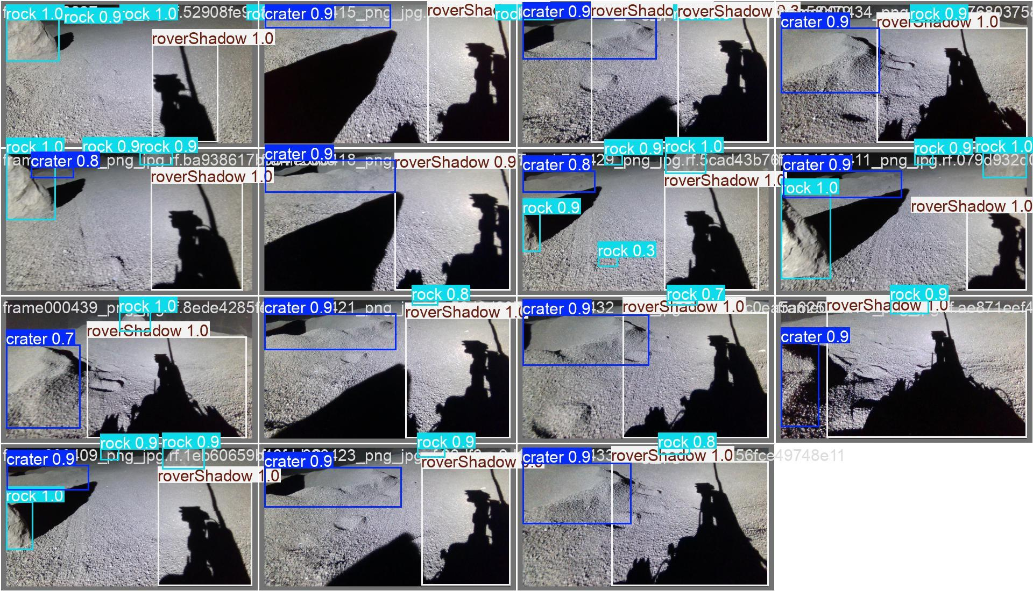
Results (100 Epochs)
Original Labeled Images
Predicted

Slide 13
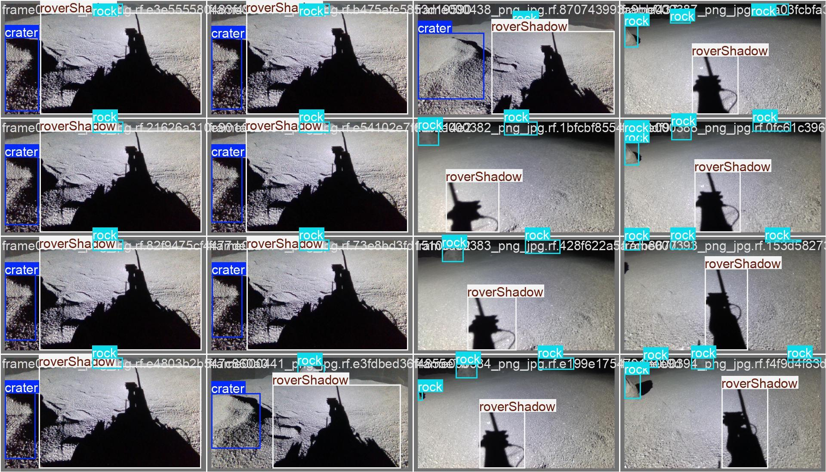
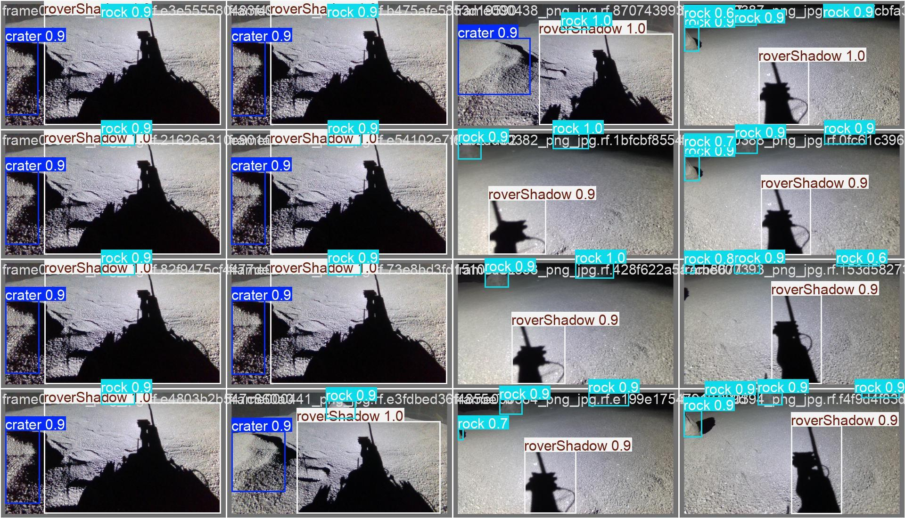
Results (250 Epochs)
Original
Predicted

Slide 14
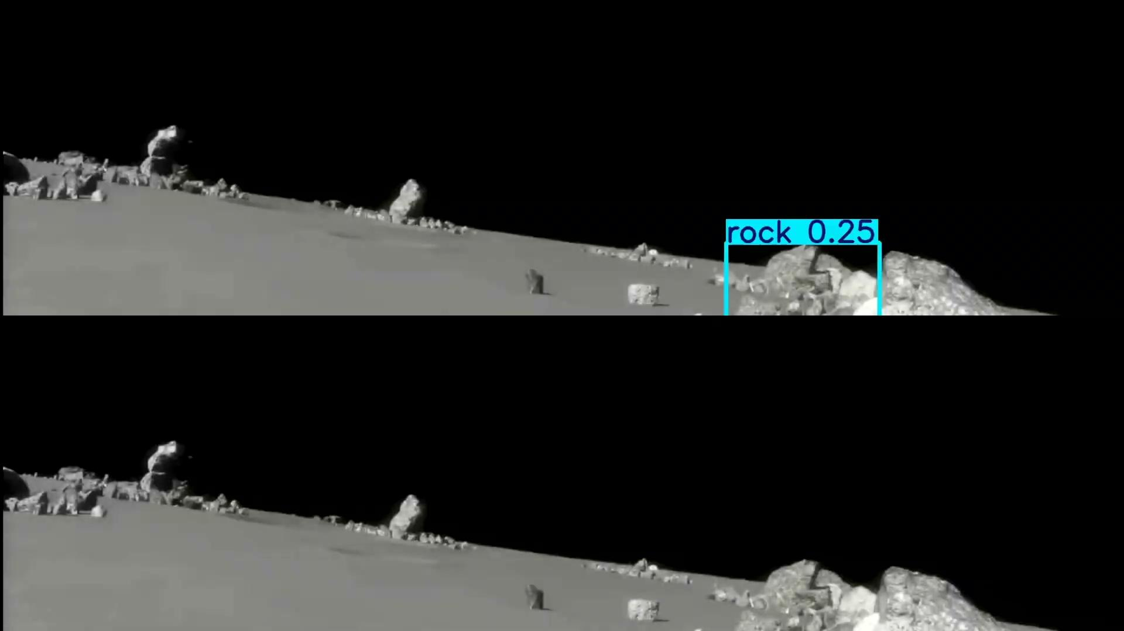
Video: 100 Epochs (Top) vs 250 (Bottom)

Slide 15
Video Analysis and Personal Thoughts
All videos in 4x speed
From first video, 250 epochs (bottom) is too much and results in too many false positives and wrong class detections (mistaking a crater for a rock or vice versa)
Confidence interval is a value from 0 to 1 that can be adjusted, with the lower the value, the more willing the model is to label an object as a class, and with the higher the value, the more sure the model has to be of an object for it to label a class (hence the name, confidence interval)
In the next video, you will see a model with a CI (confidence interval) of 0.05 on the top and the same model run with a CI of 0.50 on the bottom
As you will see, a lower CI results in more wrong class detections but a higher CI misses a lot of objects entirely, so for our purposes I believe a lower CI will be preferred

Slide 16
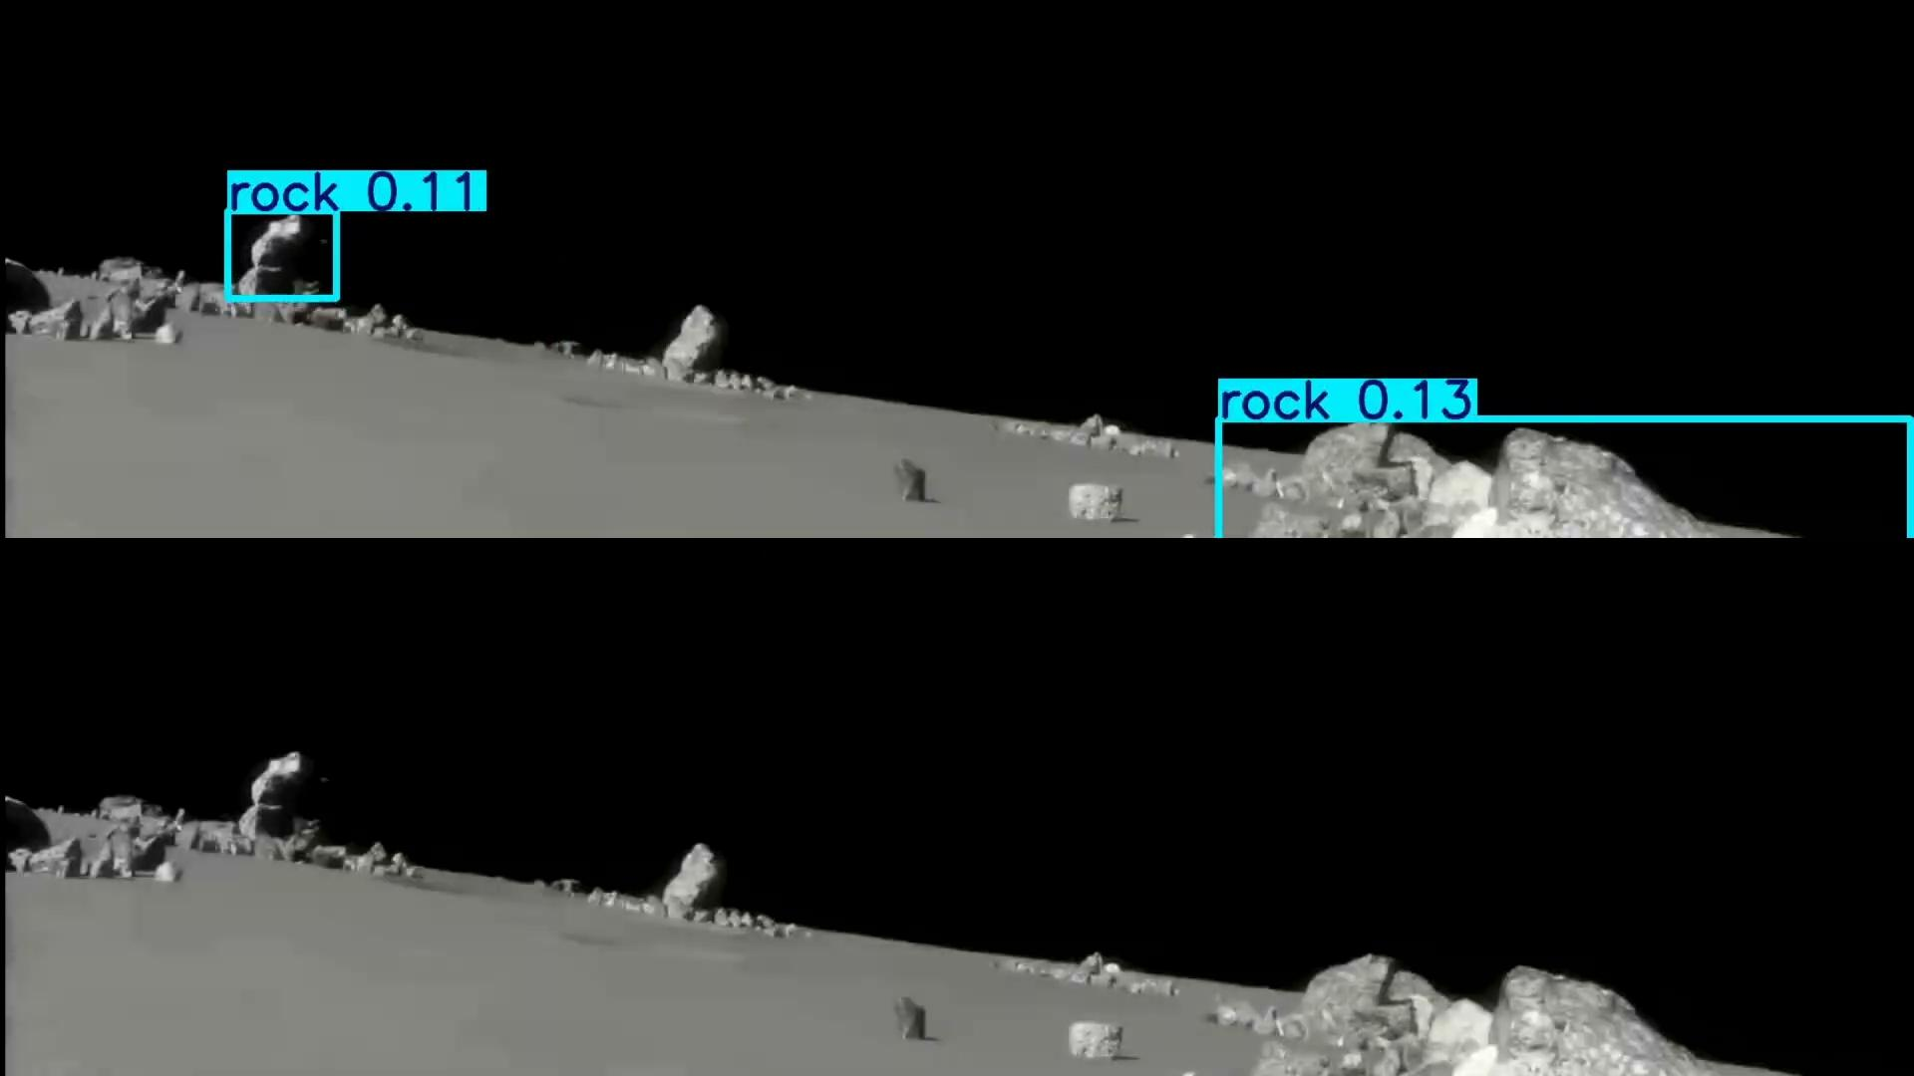
Video: 0.05 CI (Top) vs 0.50 (Bottom)

Slide 17
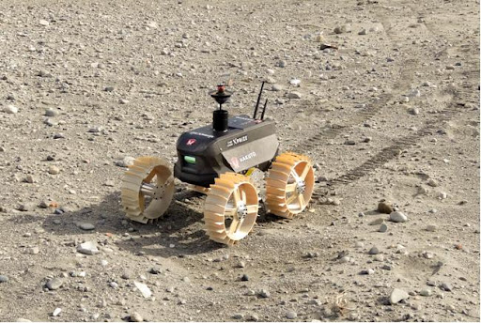
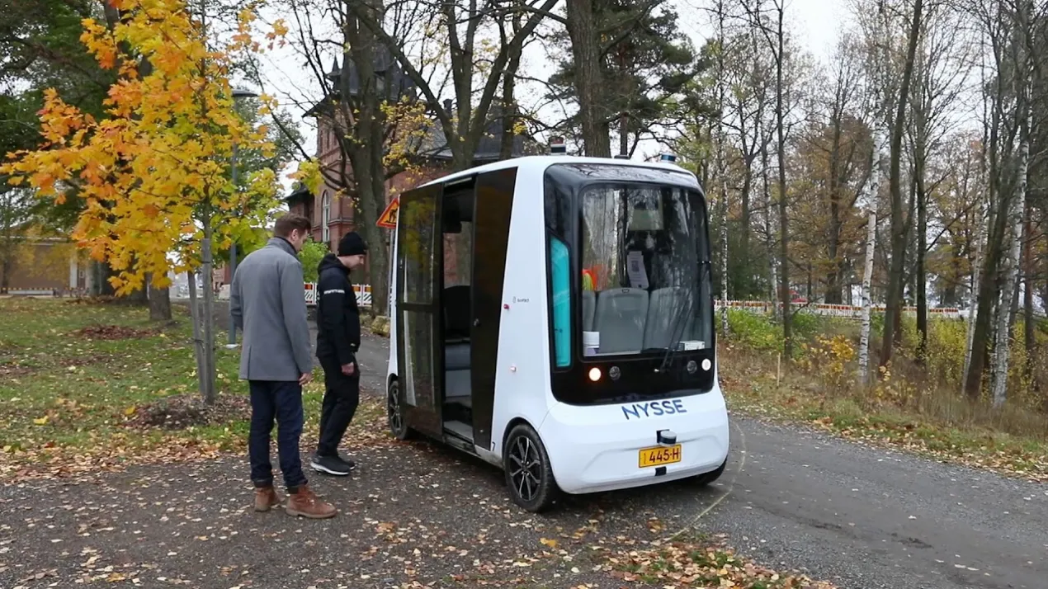
Future Work and Conclusions
Models trained with more than 150 epochs start overfitting
Lower confidence interval should be used when predicting to pick up more objects (0.05)
Future work can include implementing models into OmniLRS for autonomous navigation of lunar rovers
Real world applications such as autonomous driving and other hazard detection in everyday life

Slide 18
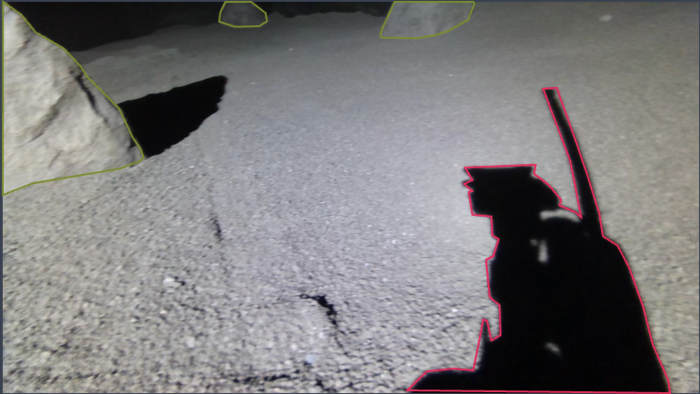
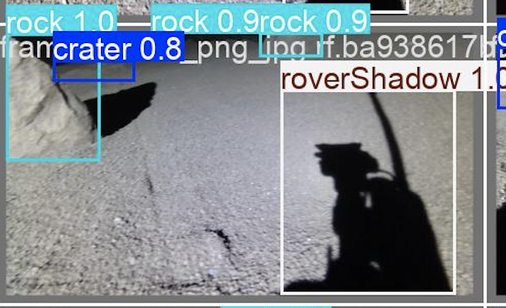
Learnings and Experiences
Frame 404
Annotating an entire dataset of images by hand is very tedious and time-consuming, ask other people for help (I have no friends to ask)
Image detection models are more advanced than I thought
There will always be some errors in the model, especially if you don’t use extremely similar images, this is compounded even more if the environments are different (example: real life lunar environment in a lab vs simulated virtual lunar surface)

Slide 19
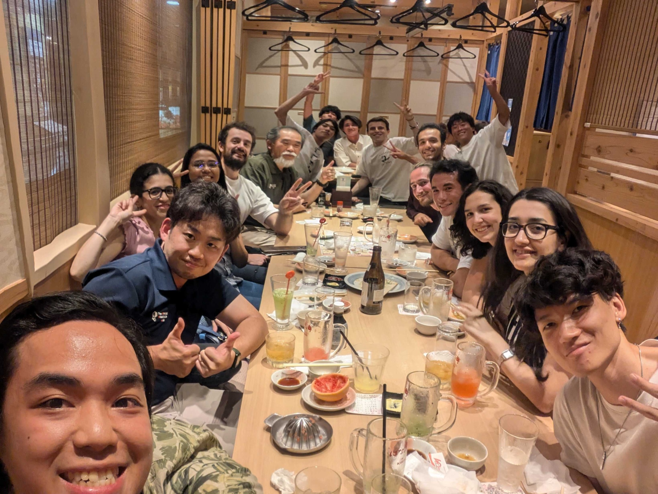
Thank you
Link to my dataset: https://app.roboflow.com/srl-onpcr/lunar-surface-segmentation/2

